Slide 1
Testing Metrics

Slide 2
Objectives
  At the end of this module, you will be able to:
  State the importance of Metrics in Testing and Quality Analysis
  Explain the Metrics Process Life Cycle
  Classify Metrics
  Explain Metrics Details with Formulas
  List the benefits of Metrics

Slide 3
Cost of Quality
  The "cost of quality" is the amount of money a business loses because its product or service was not done right in the first place. For most businesses, this can run from 15 to 30 percent of their total costs.
  Every time work is redone, the cost of quality increases. Obvious examples include:
    The reworking of created test cases
    The retesting of the scripts.
    The rebuilding of a tool.
    The correction of the data already created for execution of test cases
  Total quality costs are:
    Prevention costs
    Failure costs
    Appraisal costs
    Internal Failure costs
Total Quality Costs: The sum of the all four above costs.
Success Indicator-is an indicator depicting a trend chart with a target goal on it, the goal may be a quality, market share, or revenue target.

Slide 4
Metrics Concepts and its need
  Metrics: In system development life cycle, a metric (noun) is the measurement of a particular characteristic of a program’s/testing's performance or efficiency.
  Metrics is a combination of two or more measures used to compare s/w processes, projects, and products. Set of metrics derived from the data collected from past projects at the organization level.
  Importance of Metrics to different stakeholders
  Project Team
    Monitor and Control Project
  Senior Management
    Decision Making
    Setting organizational norms
  Customer
    Comparing different vendors
    Evaluating the performance of the vendor quantitatively
A Metric is a quantitative measure of the degree to which a system, system component, or process possesses a given attribute

Slide 5
Metrics Concepts and its need..
  Need of Metrics in Testing and Quality analysis
    To determine the quality and progress of testing.
    To calculate how much more time is required for the release
    To estimate the time needed to fix defects
    Metrics help in deciding the scope of the product that can be released by considering the defect density across modules, their importance to customers and impact analysis of those defects
Cost of the testers' salaries, the equipment, systems, software, and other tools will result in “Cost of Testing”

Slide 6
Testing Metrics Classification
The test metrics can be classified into the following three categories:
  Project Related Metrics – such as Test Size, # of Test Cases tested per day Automated, # of Test Cases tested per day –Manual , # of Test Cases created per day – Manual , Total number of review defects , Total number of testing defects , etc
  Process Related Metrics – such as Schedule Variance (SV), Effort Variance (EV), Test design/execution productivity, Test Cases and Scripts Rework Effort, etc.
  Customer related Metrics – such as Percentage of defects leaked per release, Percentage of automation per release, Application Stability Index, etc.

Slide 7











Monitoring projects through a well-defined metrics process with Goal Question Based approach
1
Metrics | Description | Threshold
Program Level Metrics
Effort Variance | This metrics is used to measure the variance in the planned efforts | < 10%
Schedule Variance | This metrics is used to measure the variance in the planned milestone dates | <10%
Budget Variance | This metrics is used to measure the variance in the planned budget | <10%
Project Level Metrics
Test Design Productivity (TCP/PD) | Size for design in TCP / efforts for writing test cases in person days | >13 TCP / PD
Test Execution Productivity (TCP/PD) | Size for execution in TCP / efforts for executing test in person days | >26 TCP / PD
Defect Rejection Ratio % | (# of defects rejected) * 100 / total number of defects logged) | <15%
Defect Leakage | Number of defects found in production that were missed during testing execution that determine the overall efficiency of the testing team | <5%
Test Coverage | # of requirements mapped by test cases and passed during a release/total number of requirements | >80%, 100% of Risk A requirements
Cost Metrics
Savings due to Test Script Reuse | (# of test cases used in subsequent releases, projects) * 100 /total number of initially created test cases | >25%
Savings due to automation | (# Of defects re-opened / # of defects were originally made for retest) *100 | <20%
GQM Planning
2
Defining GQM-Mandatory Metrics
& Estimation Mechanism
3
Data Collection
Data
Data Analysis
4
Interpretation & Reporting

Slide 8
Testing Metrics
Test Authoring Productivity
  Measures test case/script authoring productivity.
Weighted Testing Defect Density
e.g. Measures number of Weighted defects per 1000 TCP.
Product
Quality
  Defect Leakage
  Provides measure of efficiency of testing teams and indicates stability of system
Testing
Metrics
Productivity
Testing Quality
and
Effectiveness
Test Execution Productivity
  Measures test case/script execution productivity and assists implement proactive/corrective measures to improve productivity.
Test Case Effectiveness
  Signifies the % of the valid defects Mapped to the test cases
  Defect Rejection
  Provides measure of number of defects rejected during execution which assists implementing proactive/corrective measures to reduce this %.

Slide 9
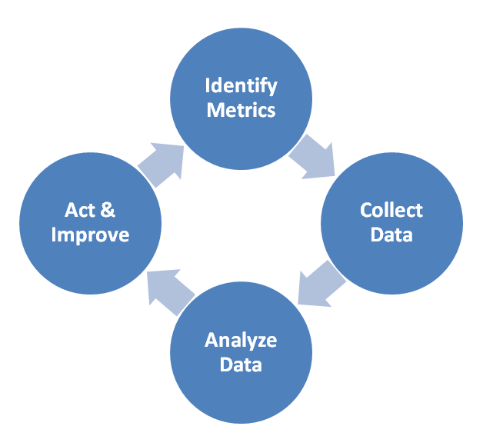

Metrics Process Life Cycle
  Three golden rules of Quality;
  Measurement has no meaning without proper recording of data
  Recording is meaningless if no analysis is carried out
  Analysis has no meaning if no action is taken
Understand
Metrics

Slide 10
Classification of Metrics
    Impacts customer’s financial bottom-line
    Impacts our capability to get more business
    Needed self-explainable classifications
    Will appeal easily to associates at all level
    Will lead to better focus
Productivity
Project Management
Software Testing Metrics
Management Program
Testing Effectiveness
Product Quality

Slide 11
Classification of Metrics
PRODUCTIVITY
TESTING
EFFECTIVENESS
PRODUCT
QUALITY
PROJECT
MANAGEMENT
Test Scripting Productivity
2. Test Execution Productivity
Test Case Effectiveness
Defect Rejection
Defect Leakage
Testing Defect Density
Effort Variance
Schedule Variance
These are good metrics to show the efficiency with which the test automation team helps the Enterprise Test Group reduce risk. Consider the following metrics:
    The percentage of test effort saved for a given product due to test automation
    The number of people working on the test automation team
Remember that good metrics map to specific objectives and motivate correct behavior by the people involved in the process being measured.

Slide 12
Productivity Metrics – Test Scripting Productivity
Definition:
    The ratio of Size of Design in TCP and total person days efforts required to script them is called as the Test Scripting Productivity Metric. Productivity is measured in TCP per Person days.
Objective
    Measure test case/script writing productivity and implement proactive/corrective measures to improve productivity further.
Formula
    Test scripting productivity = Size for Design (TCP) / Efforts for designing the Test Script in person days.
    Script Design includes review/rework/data preparation
    Includes time for Query resolution, time taken for document referring during test case scripting, time for uploading of test cases, time for peer reviews, actual scripting and modification time.
Potential Inferences & Usability
    Low productivity may indicate root causes like high rework, low reusability, requirement of training associates, improvement need in review process etc.
    Comparison of productivity across similar projects should increase practice of sharing best practices for preparation phase.
Challenges & Constraints
    Magnitude of work may force use of approximate value resulting into some error margin.
    How to Interpret
    The number indicates the Scripting Productivity of the team. Higher number indicates efficient scripting.

Slide 13
Productivity Metrics – Test Execution Productivity
Definition:
    The ratio of Size of Execution in TCP and total person days efforts required to execute them is called as the Test Execution Productivity Metric. Productivity is measured in TCP per Person days.
Objective
    Measure test case/script execution productivity and implement proactive/corrective measures to improve productivity further.
Formula
    Test execution productivity = Size of Execution in TCP / Execution Effort in person days
    The Total execution effort includes execution/defect retest/downtime effort
Potential Inferences & Usability
    Low productivity may indicate root causes like high rework, requirement of training associates, high number of issues etc.
    Comparison of productivity across similar projects should increase practice of sharing best practices for execution phase.
How to Interpret
    The number indicates the Execution Productivity of the team. Higher number indicates efficient execution.

Slide 14
Testing Effectiveness Metrics – Test Case Effectiveness
Definition:
    The percentage of the test cases that are useful to reveal the defects is called as the Test Case Effectiveness Metric.
Objective
    This metric signifies the percentage of the test cases that are useful to reveal the defects.
    Provide indications for implementing proactive/corrective actions to improve capabilities of test cases and make them more effective in discovering defects.
Formula
    Test case effectiveness = (Number of defects mapped to test cases / Total number of valid defects )*100
Potential Inferences & Usability
    Low effectiveness indicates requirement of improvement in test cases, need to train associates etc.
    Inputs should go to planning of next project/release with the objective of achieving 100% effectiveness.
How to Interpret
    Higher the number better is the Test case effectiveness.

Slide 15

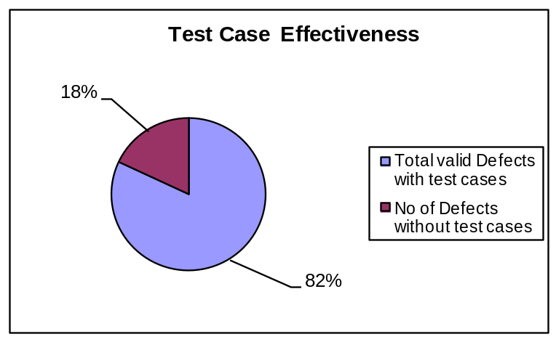
Example:- Test Case Effectiveness
Formula:
Test Case Effectiveness: (111-20/111) *100 = 81.98 %
Team | Total Valid Defects | Total valid Defects with test cases | No of Defects without test cases
Testing Team A | 111 | 91 | 20

Slide 16
Testing Effectiveness Metrics – Defect Rejection
Definition
    The percentage of Rejected defects to the total number of defects that are logged is called as the Defect Rejection Metric.
Objective
    Provide measure for number of defects rejected during execution phase.
Formula
    Defect Rejection = (Total valid number of rejected defects / Total number of defects) *100
Potential Inferences & Usability
    High rejection rate indicates development & testing are not in sync, team needs training etc.
How to Interpret
    A high number signifies poor understanding of functionality/application knowledge

Slide 17
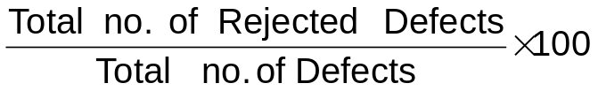
Example:- Defect Rejection
Formula:
Team | Total Defects | Rejected Defects
Testing Team A | 120 | 09
Defect Rejection Percentage:
(09/120)*100= 7.5 %

Slide 18
Testing Effectiveness Metrics – Defect Leakage
Definition
    The percentage of Leaked defects to the total number of defects that are logged is called as the Defect Leakage Metric.
Objective
    Provide measure for efficiency of testing teams and indicates stability of system.
Formula
    Defect Leakage = ((Total valid defects raised in phase n+1)/ (Total valid defects raised in phase n + Total valid defects raised in phase n+1)) *100
Potential Inferences & Usability
    High defect leakage indicates testing team is not efficient. Root causes can be lack of understanding of application, associates not trained in testing, late changes in application etc.
    Should be part of inputs to planning of next project/release.
Challenges & Constraints
    All teams don’t get post production data as of now. Few teams may find it difficult to identify defects from their scope from post production data.

Slide 19
Example:- Defect Leakage
Formula:
Team | Total Valid Defects In SIT (Phase:-n) | Total Valid Defects in UAT (Phase:-n+1)
Testing Team A | 111 | 4
Defect Leakage:
(4/(115)*100=3.47 %

Slide 20
Product Quality Metrics – Testing Defect Density
Definition:
    The number of valid defects per executed test script is called as Test Defect Density
Objective
    This metric measures average number of defects per test script executed
Formula
    Testing Defect Density = Total no. of valid defects / Total test scripts executed
Potential Inferences & Usability
    High density indicates issues in quality of the product.
    Provides quick snapshot of quality of the product.
    Analysis like Pareto can help in finding key root causes.
Data Owner
    Delivery teams
How to Interpret
    The number indicates the average no of defects per test script. Higher the number lower the product quality & higher test case effectiveness & vice versa

Slide 21
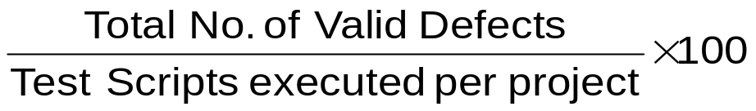
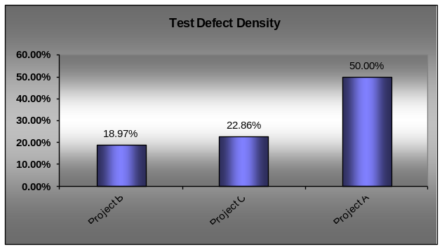
Example:- Defect Density
Formula:
Defect Density : (111/425)*100=26.12%
Sr. No. | Projects | Total Test Scripts | Total Defects Logged | No. of Valid defects | Project wise Def Density
1 | Project A | 174 | 37 | 33 | 18.96%
2 | Project B | 76 | 43 | 40 | 22.86%
3 | Project C | 175 | 40 | 38 | 50.00%
 |  | 425 | 120 | 111 | 26.12%

Slide 22
Project Management Metrics – Effort variance
Definition
    This gives the variance between the planned and the actual effort. Tracking this metric helps in improving the planning, so the projects can be planned better and completed within the budget.
Objective
    Measure the variance in the planned efforts.
Formula
    Effort variance = (Actual Hours – Planned Hours) * 100
    Planned Hours
    Note: Estimated hours reflects most recent estimates.
Potential Inferences & Usability
    Requirement instability
    Application instability
    Complexity of the system
Data Owner
    Delivery teams.

Slide 23
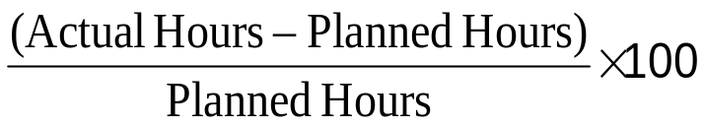
Example:- Effort Variance
Formula:
Project | Actual Effort (in hours) | Planned Efforts (in hours)
Project A | 63 | 45
Effort Variance:
(63-45)/(45)*100= 40 %

Slide 24
Project Management Metrics – Schedule variance
Objective
    Measure the variance in the planned dates.
Formula
    Schedule variance = ((Actual end date – Actual start date) – (Planned end date-Planned Start Date)) * 100
  (Planned end date - Planned start date)
    Note: Planned dates reflects dates from most recent project plan. Also the difference in dates in above formula is calculated based on NET WORK DAYS, i.e.., ignoring holidays.
Potential Inferences & Usability
    Requirement instability
    Application instability
    Complexity of the system

Slide 25
Example:- Schedule Variance
Formula:
Projects | Planned Start Date | Planned End Date | Actual Start Date | Actual End Date
Project A | 1-Jun-15 | 4-Jun-15 | 2-Jun-15 | 5-Jun-15
Schedule Variance:
(4-4)/(4)*100= 0 %

Slide 26
Benefits of Metrics
  Benefits of Metrics
    Finance
  Improve profitability/ Reduce Cost Overruns
  Process
    Improve Productivity
    Meet on-time Delivery Commitment
    Reduce Development Cycle Time
    Improve Product Quality
    Reduce Cost of Quality
    Reduce Rework
  Customer
    Improve Customer Satisfaction Index
  People
    Improving training Effectiveness
    Improving internal Satisfaction of the associates

Slide 27
Summary
  In this module, you learnt about:
    The importance of Metrics in Testing and Quality Analysis
    The Metrics Process Life Cycle
    Classification of Metrics
    Metrics Details with Formulas
    Benefits of Metrics

